Slide 1

Generative Poetry
Capstone Project
Metis Data Science Bootcamp
By Ouyang Yingzhao
Photo by Álvaro Serrano on Unsplash

Slide 2
Objectives
Use a poetry corpus…
…to train a poetry generator

Slide 3

Why should we care?
Can be used as a spur for further poetry and creative writing
If poems can be generated based on themes/images, can have broad applications e.g. in advertising
Photo by Hannah Olinger on Unsplash

Slide 4

The data
Photo by Debby Hudson on Unsplash

Slide 5
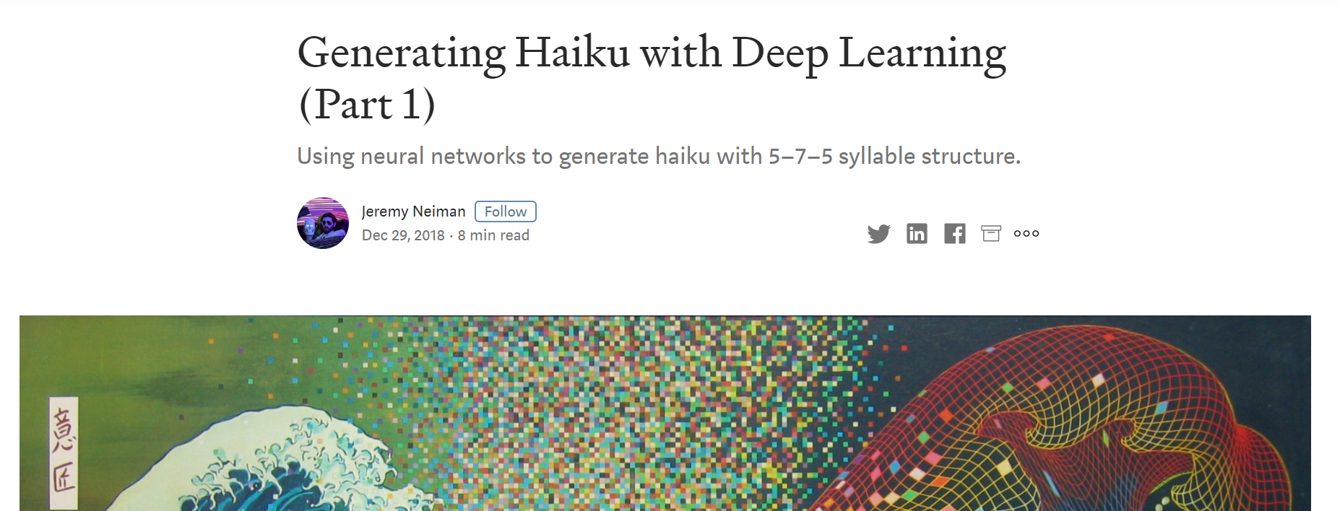
Poetry dataset
Retrieved from the GitHub of Generating Haiku with Deep Learning (Part 1)
Dataset was in turn pieced together from 3-line poems from various datasets

Slide 6
Poetry dataset: breakdown
img2poems
haikuzao
4,800 poems
1,136 poems
11,808 poems
sballas
8,142 poems
gutenberg
5,524 poems
tempslibres
31,410 poems in total

Slide 7

The models
Photo by Alina Grubnyak on Unsplash

Slide 8

Model used: LSTM

Slide 9


Model setups
Setup A
Cleaned words as tokens
Setup B
No cleaning; using Stanford GloVe embeddings
Click for details
Click for details

Slide 10
Training process
Setup A: Cleaned tokens
Setup B: GloVe
Trained for 200 epochs
Categorical cross-entropy loss of 3.7964
Trained for 109 epochs
(Sparse) categorical cross-entropy of 2.4030
No improvements beyond

Slide 11
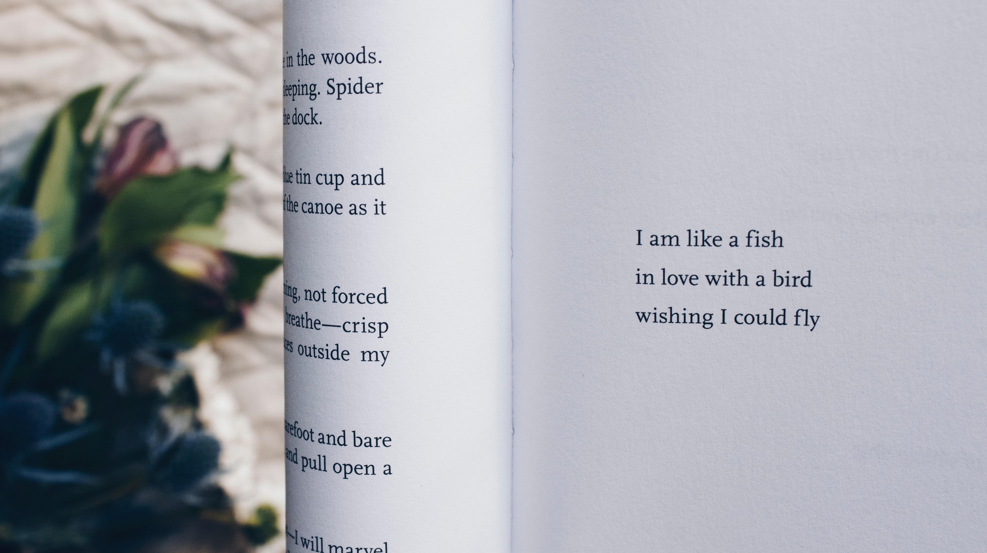
The results
Photo by Thought Catalog on Unsplash

Slide 12




Setup A: Cleaned tokens
what smoke
more rumpled sunsets
in the conch
morning night
before shadows
in the horses
february night
the sand
of his firs
tis sand
the same of bonfires
on the scorching

Slide 13




Setup B: GloVe
long after the rain
the pregnant woman
swims into the mud
winter wind
the baby hippo sings
on the sidewalk
autumn creek
the fox's eyes
in the closet shop
behind the door
the smell of water
on the river-bed

Slide 14
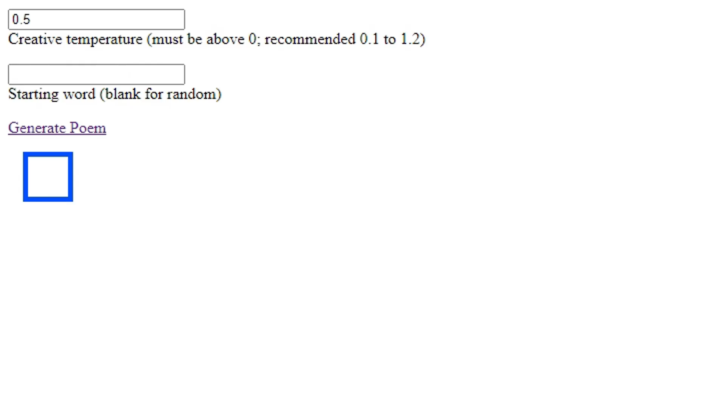



Here’s a demo!

Slide 15

Observations
Setup B appears to produce natural-sounding poems more often than Setup A
However, neither setup seems to produce such poetry more than ~50% of the time
Setup B is very large (more than 1 GB vs 81 MB for Setup A)
Can try fewer embeddings to see how the results are affected
Both models are restricted to the vocabulary of the dataset
Setup B’s vocabulary could be extended by the keys in GloVe

Slide 16
Future work
Use additional seeds to improve relevance e.g. sentiment, themes, pictures
Use additional features to improve quality e.g. syllables, parts-of-speech
Tweak the hyperparameters e.g. additional layers/nodes, different activation functions
Add more poetry; clean up existing datasets

Slide 17


To contact me:
Yingzhao Ouyang
Data Scientist
https://www.linkedin.com/yzouyang
https://www.medium.com/@yzouyang

Slide 18
Model setup: LSTM
*tokens are for illustrative purposes

Slide 19
Model setup: LSTM with Stanford GloVe embeddings
*tokens and embeddings are for illustrative purposes

Slide 20
LSTM word model (temperature = 0.2)
The decent…
…and the not-so-decent
far the sire
i the colored of the tv
lara the cat fades the tv
heaven the cat of the tv
a | like the
t the of | split the of the approaching
the the the of the | notes the the ebb
starfire the of neon approaching nuptials | cancer the

Slide 21
LSTM word model (temperature = 0.5)
The decent…
…and the not-so-decent
tis sand the same of bonfires on the scorching
softly of the new pointless a
the crowd is the moors the blue
where you the hum out the woodstove
only the are of worshipper in a | end the the of monday in the
autumn the breathest of the | coldest a the cat of the the screen
what the quarrelled pret | and to the the corpses of keeps poets
laugh the awe the to | all the chimney the cherry of to the

Slide 22
LSTM word model (temperature = 0.8)
The decent…
…and the not-so-decent
his the loft sister was the sky from the keep ladder
february night the sand of his firs
bricks the honey of
i a the butterfly of my and yesterday
but the the knife in sweeter | save of of
raked the awe of still that the | blush eve a bird layer stuck share my
this egg that life man translates sun the with grew the you the passage his may a | a drop the many ye the the the
a stone star the a a a | the stops of the of winter so someone in on marbles

Slide 23
LSTM word model (temperature = 1.0)
The decent…
…and the not-so-decent
what smoke more rumpled sunsets in the conch
o for the guard of our dazzled kiss why now er
morning night before shadows in the horses
summer clouds the book of love
starlit on tree fear without the s voice not seeing and our ll all you the was for in have me of in my time the be pacific hide
there let ache who thee break back the the river
winter of a the crack of one in the pantry
summer host there until she beautiful in all two can with soul off was a

Slide 24
Bonus: poems from previous epochs
then flower gone at old and good me | winter the oppress the agitate of i the woods | pron star the loon devout bounces wildfires in the moon | nearly the pot my the cow
published trees a years link dog | continuing rain i the salesman ultrasound of grandparents | morning the honey ministry s | father a the cat s in a plastic
and the perils assigned | silenus the sound of the | roots the smell of siren the the door | kingfisher the evening of the cow s udder
the through slap tore the cloud | overcast in malingers

